Slide 1
FIGnition — Turtle Graphics
FIG-Forth on AtMega168

Slide 2

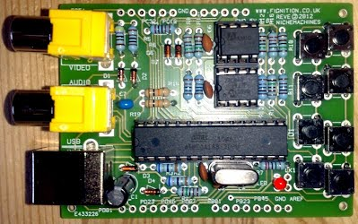
By Julian Skidmore
FIG-Forth
AtMega168
20MHz
8Kb SRAM
384Kb Flash
8-button keypad (or FIGkeys)
Flash block editor (or AvrDude)
DIY ~£20

Slide 3
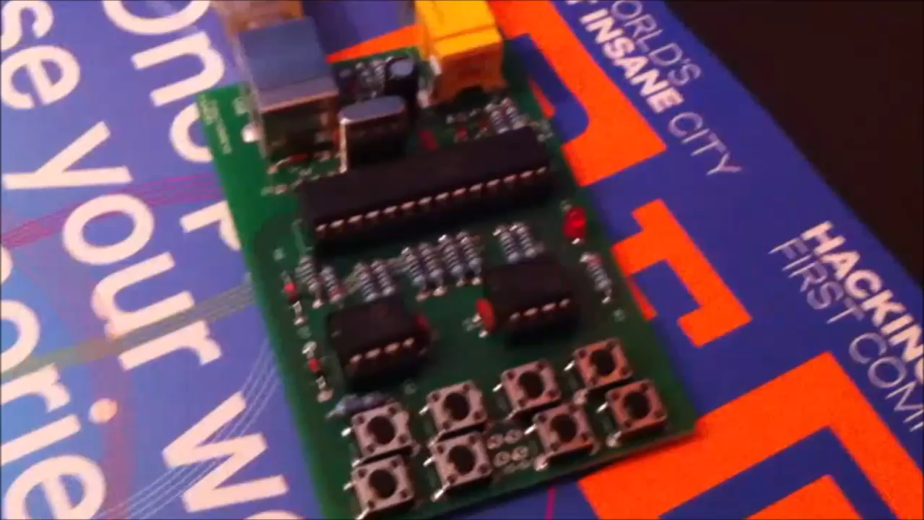

Slide 4
0 var x 0 var y 0 var angle
0 var dx 0 var dy
: heading ( ang --)
dup angle !
dup sin dx !
45 + sin dy ! ;
: turn ( turn--)
angle @ + heading
;

Slide 5
0 var x 0 var y 0 var angle
0 var dx 0 var dy
: heading ( ang --)
dup angle !
dup sin dx !
45 + sin dy ! ;
: turn ( turn--)
angle @ + heading
;

Slide 6
: coord @ 256 / 80 + ;
: draw x coord y coord plot ;
: forward ( dist--)
1 do dx @ x +! dy @ y +! draw loop
;
: jump ( dist--)
dup dx @ * x +!
dy @ * y +!
;

Slide 7
: turtleStart
1 vmode 1 pen cls
0 0 go 0 heading
;
: turtleEnd
key 0 vmode
;
: clear
9380 C80 0 fill
;

Slide 8
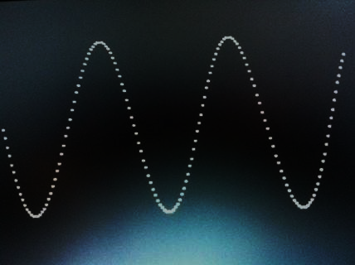
160 0 do i i sin 4 / 80 + plot loop

Slide 9
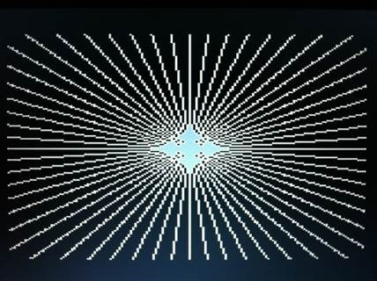
60 0 do 0 0 jump i heading 110 forward loop

Slide 10
hex create sinTable 1B , 354F , 687F , 96AB ,
BECE , DDE9 , F3F9 , FEFF , decimal
: sin ( ang -- sin[ang])
>r r abs >r r
15 mod r 30 mod 14 > if
15 swap -
then
sinTable + c@ r 60 mod 30 > if
minus
then
r> drop r> drop
;

Slide 11
hex create sinTable 1B , 354F , 687F , 96AB ,
BECE , DDE9 , F3F9 , FEFF , decimal
: sin ( ang -- sin[ang])
>r r abs >r r
15 mod r 30 mod 14 > if
15 swap -
then
sinTable + c@ r 60 mod 30 > if
minus
then
r> drop r> drop
;

Slide 12
hex create cosTable -2 , F9F2 , E9DD , CEBD ,
AA95 , 7F67 , 4E34 , 1A00 , decimal
: cos ( ang -- cos[ang])
abs 60 mod dup 29 > if
60 swap -
then
dup 14 > if
-1 30 rot -
else
1 swap
then
cosTable + c@ 1+ *
;

Slide 13
hex create cosTable -2 , F9F2 , E9DD , CEBD ,
AA95 , 7F67 , 4E34 , 1A00 , decimal
: cos ( ang -- cos[ang])
abs 60 mod dup 29 > if
60 swap -
then
dup 14 > if
-1 30 rot -
else
1 swap
then
cosTable + c@ 1+ *
;

Slide 14
: coord @ 256 / 80 + ;
: draw x coord y coord plot ;
: forward ( dist--)
1 do dx @ x +! dy @ y +! draw loop
;

Slide 15
: coord @ 256 / 80 + ;
: draw x coord y coord plot ;
: forward ( dist--)
1 do dx @ x +! dy @ y +! draw loop
;

Slide 16
: forward ( dist--)
>r dx @ x @ y @ dy @
r 0 do
>r r + >r over +
dup 8 >> r 8 >> plot
r> r>
loop
drop y ! x ! drop
r> drop
;

Slide 17
: forward ( dist--)
>r dx @ x @ y @ dy @
r 0 do
>r r + >r over +
dup 8 >> r 8 >> plot
r> r>
loop
drop y ! x ! drop
r> drop
;

Slide 18
0 var x 0 var y 0 var a
0 var q 0 var w
hex create n -2 , F9F2 , E9DD , CEBD ,
AA95 , 7F67 , 4E34 , 1A00 , decimal
: c abs 60 mod dup 29 > if 60 swap - then dup 14 > if -1 30 rot - else 1 swap then n + c@ 1+ * ;
: h dup a ! dup c w ! 45 + c q ! ;
: t a @ + h ;
: f >r dx @ x @ y @ dy @ r 0 do >r r + >r over + dup 8 >> r 8 >> plot r> r> loop drop y ! x ! drop r> drop ;
: j dup q @ * x +! w @ * y +! ;
: k >r 80 + 8 << r> ! ;
: g y k x k ;
: s 1 vmode 1 pen cls 0 0 g 0 h ;
: e key 0 vmode ;
: r 9380 C80 0 fill ;

Slide 19

-50 50 j 20 0 do 100 f 21 t loop

Slide 20

0 50 0 do 2 + dup f 14 t loop

Slide 21
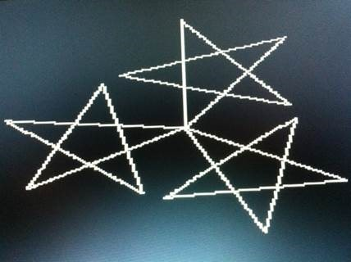
: star 5 0 do 80 f 24 t loop ;
3 0 do star 20 t loop

Slide 22

: circle 60 0 do 4 f 1 t loop ;
15 0 do circle 4 t loop

Slide 23
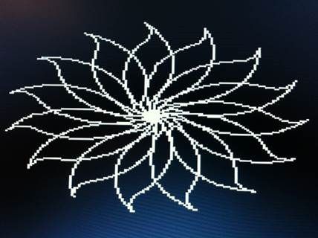
: petal 15 0 do 5 f 1 t loop 15 0 do 2 f -1 t loop ;
15 0 do petal 30 t petal 30 t 4 t loop

Slide 24
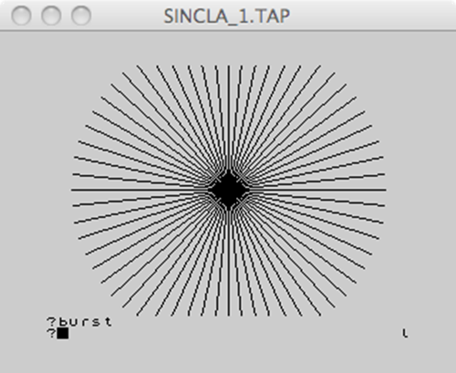
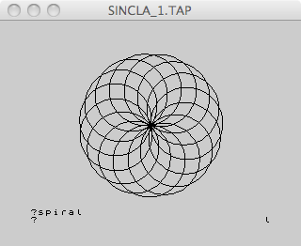
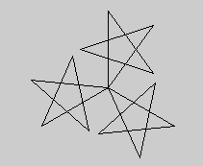
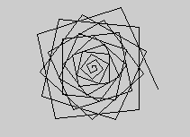
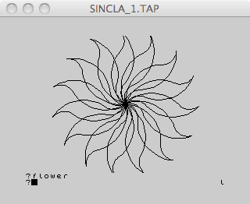
 | ZX Spectrum | FIGnition
 | 14.79s | 1.2s | +12×
 | 2:14.47s! | 3.8s | +35×!
 | 3.34s | <0.4s | +8×
 | 13.28s | <1s | +13×
 | 2:15.44s! | 3.72s | +36×!

Slide 25
FIGnition: https://sites.google.com/site/libby8dev/fignition http://github.com/Snial/FIGnition
inFUZE Bundle (RS Components): https://uk.rs-online.com/web/p/single-board-computers/7755003/
Turtle: http://github.com/ashleyf/FIGTurtle

